Slide 1
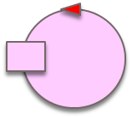
ctxFridge
fridge
ctxRobot
Check food
Food available
Food not available
robot
Expose state
ctxMaitre
Food not available
Expose state
Prepare
Add
Clear
Stop
Reactivate
Prepare
Add
Clear
Stop
Reactivate
Consult state
user
maître

